Slide 1
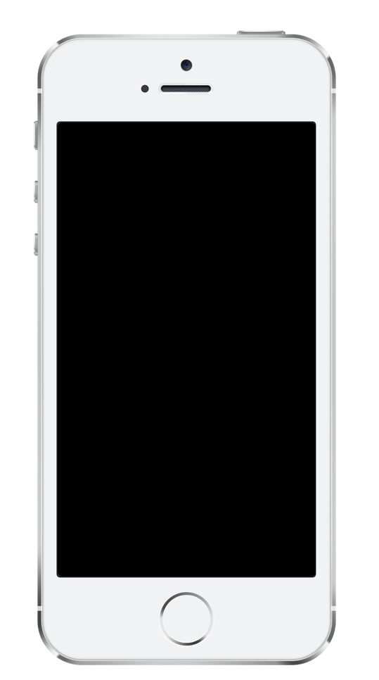
Add text here…

Slide 2
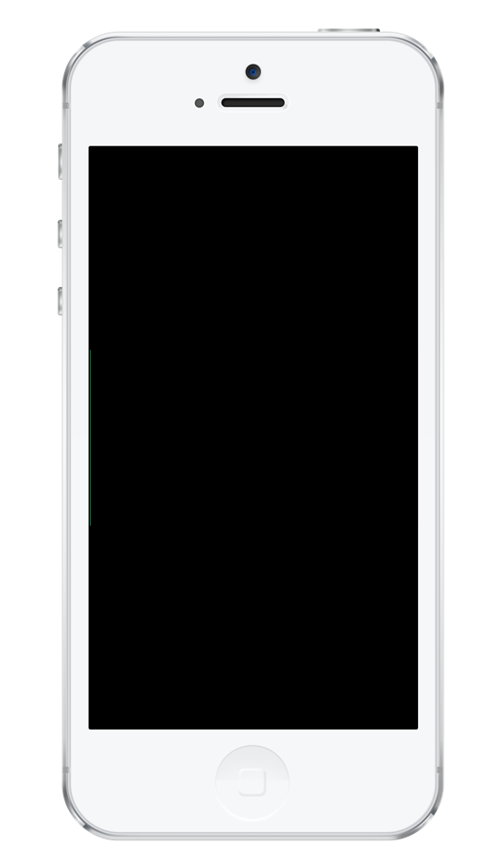
Add text here…

Slide 3
4-Inch Retina Display (Required) iPhone 5s (top) / iPhone 5 (below)
You’re required to upload at least one of these screenshots. Up to four additional optional screenshots can be uploaded.
Screenshot requirements are:
640 x 1136 pixels for portrait (full screen)
1136 x 640 pixels for landscape (full screen)
How to use this template:
Do not resize the blue box. The box is your work area and has been sized to the correct dimensions for the App Store. You can however change the color (including white) or add a fill. (Dimension: 19.2 x 10.84 cm)
Feel free to resize, crop or remove the device to fit your needs. Ensure that the crop lines do not exceed the space of the box (Otherwise your image will save at an incorrect dimension)
Import your app screenshot as an image as lay it over the device. Resize to fit. Note: Apple suggest that you do not include the device status bar in your screenshots.
To save as an image select all the elements and left click “Save as image”. You can save as a .jpeg or .png. All saved images must be 72 dpi, RGB, flattened and with no transparency to be accepted by the App Store.

